Slide 1
Chapter 6
Groups and Teams

Slide 2
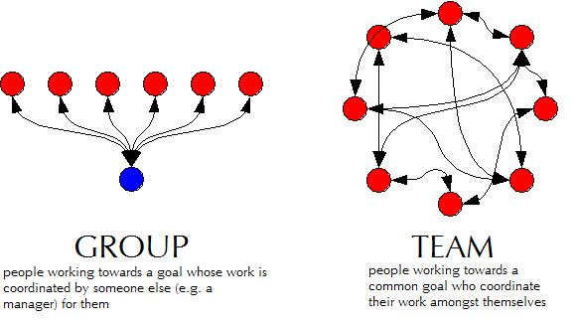
What’s the difference

Slide 3
So what do the arrows mean?
Groups:
Have a functional leader
Generate output as instructed by leader
All members work independently
Teams:
Members work together to achieve common goal
Performance is self monitored

Slide 4
How to tell the difference…
Ask yourself, do any of these apply:
Common Purpose
Specific Performance Goals
Mix of Complementary Skills
Strong Commitment as to how goals will be achieved
Mutual Accountability

Slide 5
How to tell the difference…
If the majority of those are present, chances are you have a “team” on your hands, not a group.
See also: pg. 113 of “The Discipline of Teams”

Slide 6
Managing Each
Don’t manage a group like a team.
Don’t manage a team like a group.
Either way, results are minimized when this mistake is made.

Slide 7
Managing Each, cont.
Groups need direction, supervision, and performance management
Teams need motivation and training
Teams also need trust amongst team mates. The manager fosters trust.

Slide 8
References
Liden Robert C., Wayne Sandy J., Kraimer Maria L. "Managing Individual Performance in Work Groups." Human Resource Management, Vol. 40 Iss: 1, pg. 63-72. John Wiley and Sons, Inc. p. 4 April 2001. Internet. Accessed 19 November 2013.
Katzenbach Jon R., Smith Douglas K. "The Discipline of Teams." Harvard Business Review. p. March - April 1993. Internet. Accessed 14 October 2013.

